Slide 1
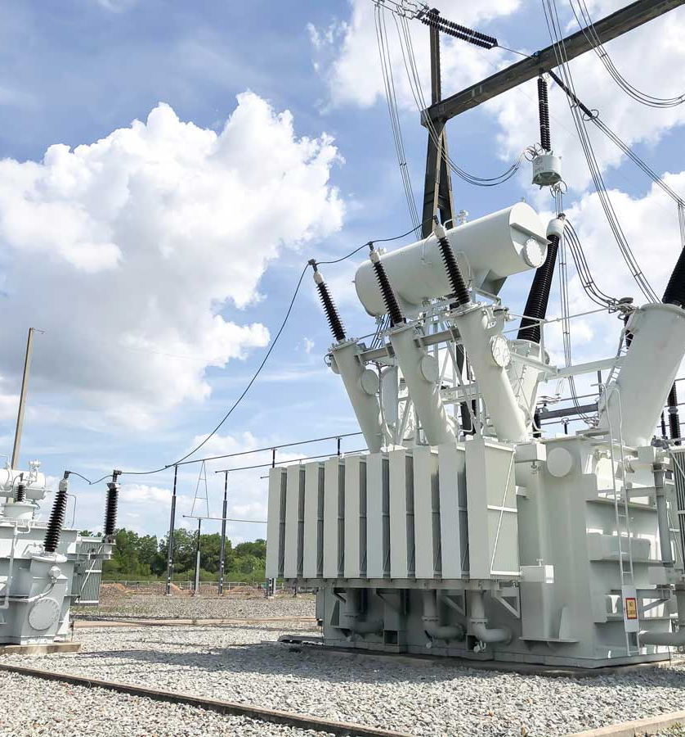



webinar
Insulation concepts to optimize the design of liquid-filled transformers
March 26th | 15:00 CET | 10:00 EST
Thomas Prevost
Vice President Technology & Innovation
Jason Beaudoin
Engineering Services Manager
Brad Greaves
Laboratory Services Manager

Slide 2


How to ask a question?
Minimized GoToWebinar panel
→ Click arrow to enlarge
Enlarged GoToWebinar panel
Expand the field Questions
Type your question and send to Organizers or to All

Slide 3
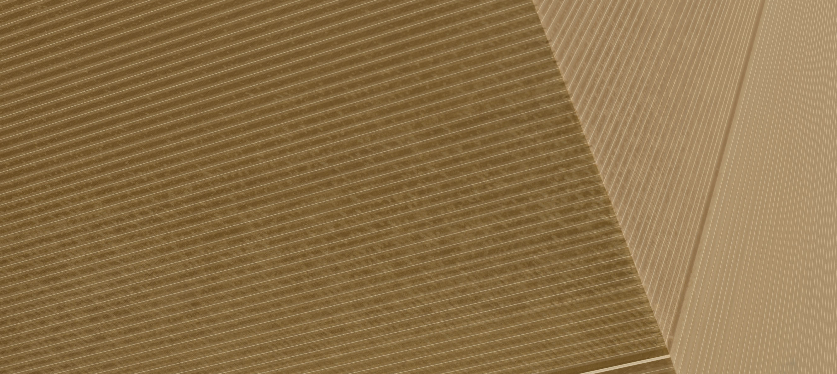
Insulation Concepts to Optimize the design of liquid-filled Transformers
Thomas Prevost, brad greaves, & Jason Beaudoin

Slide 4
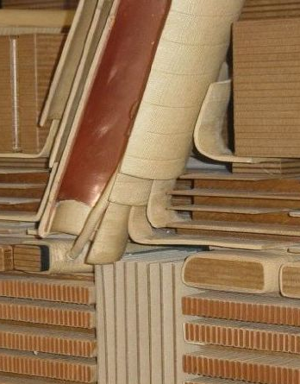
Insulation design concepts
01
Optimized Ingredients for Solid Transformer Insulation
02
Optimized Space Factor In The Windings
03
Optimized Short Circuit Resilience
04
Optimized Stress Distribution By Understanding Material Permittivity
05
Optimized Dielectric Clearances By Use Of Barrier System
06
Optimized Surface Stress Using Contoured Insulation

Slide 5
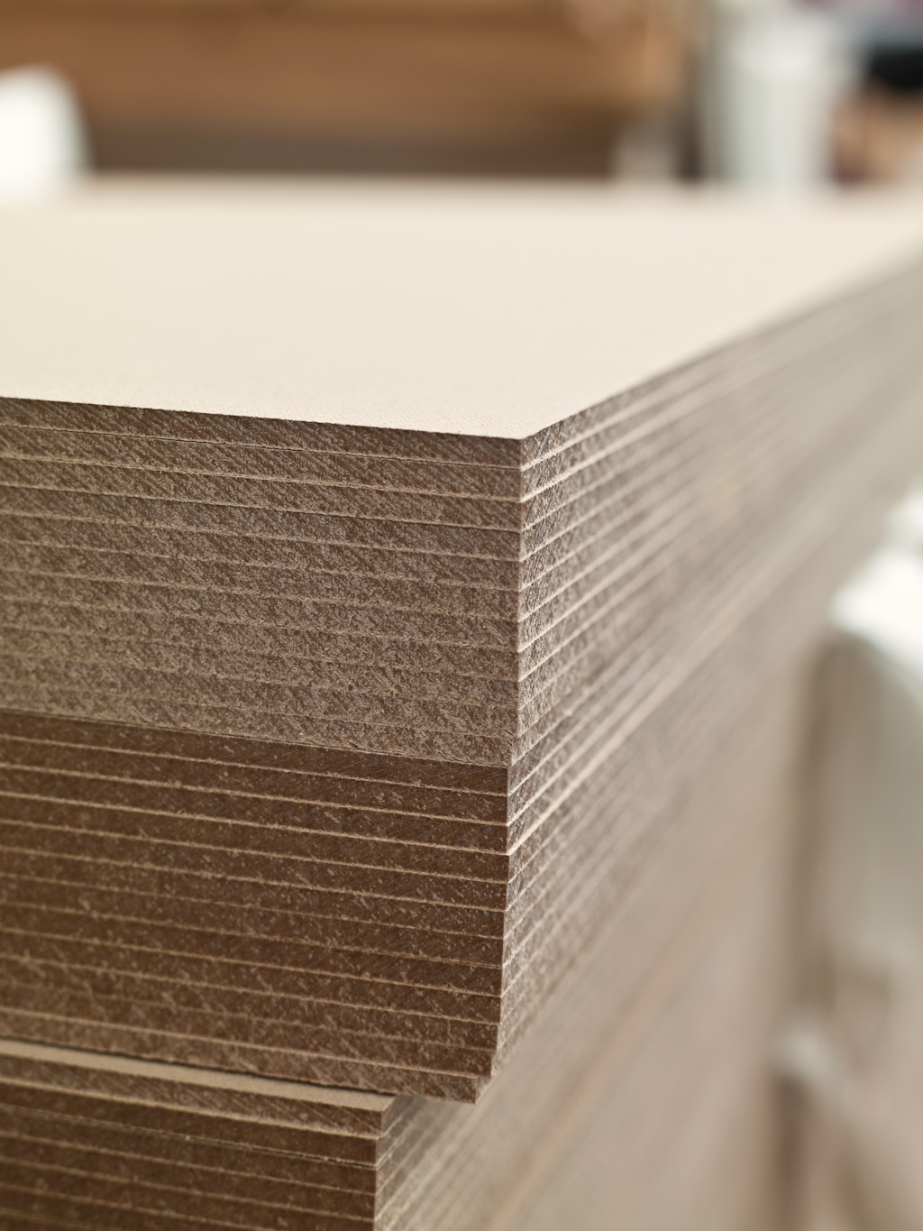
Optimized ingredients for solid transformer insulation
Performance Requirements
Dielectric
  High Breakdown Voltage
  Low Dissipation Factor
Mechanical
  High Tensile Strength
  High Flexure Strength
  Low Compression
Thermal
  High Thermal Class
  High Degree of Polymerisation
Superior performance is achieved by using optimized ingredients……

Slide 6
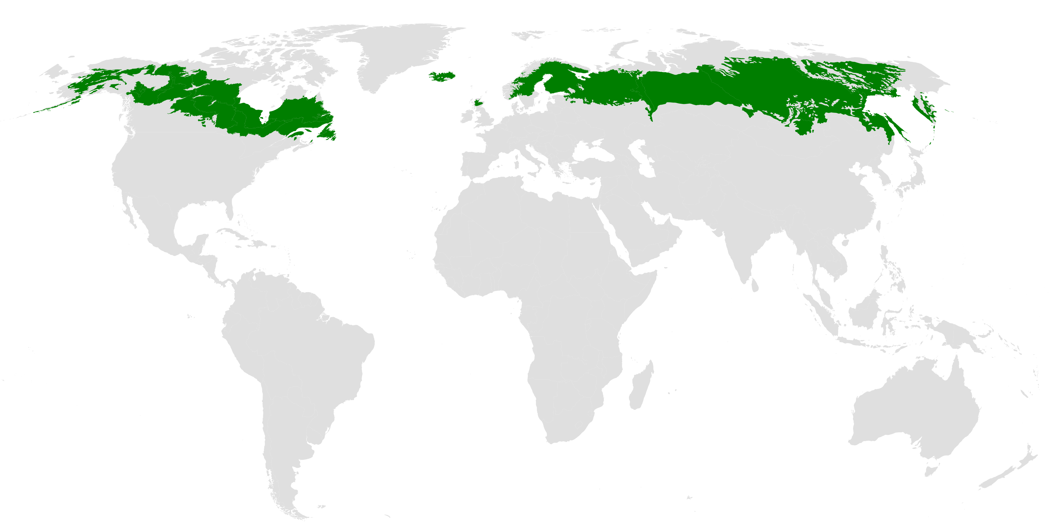
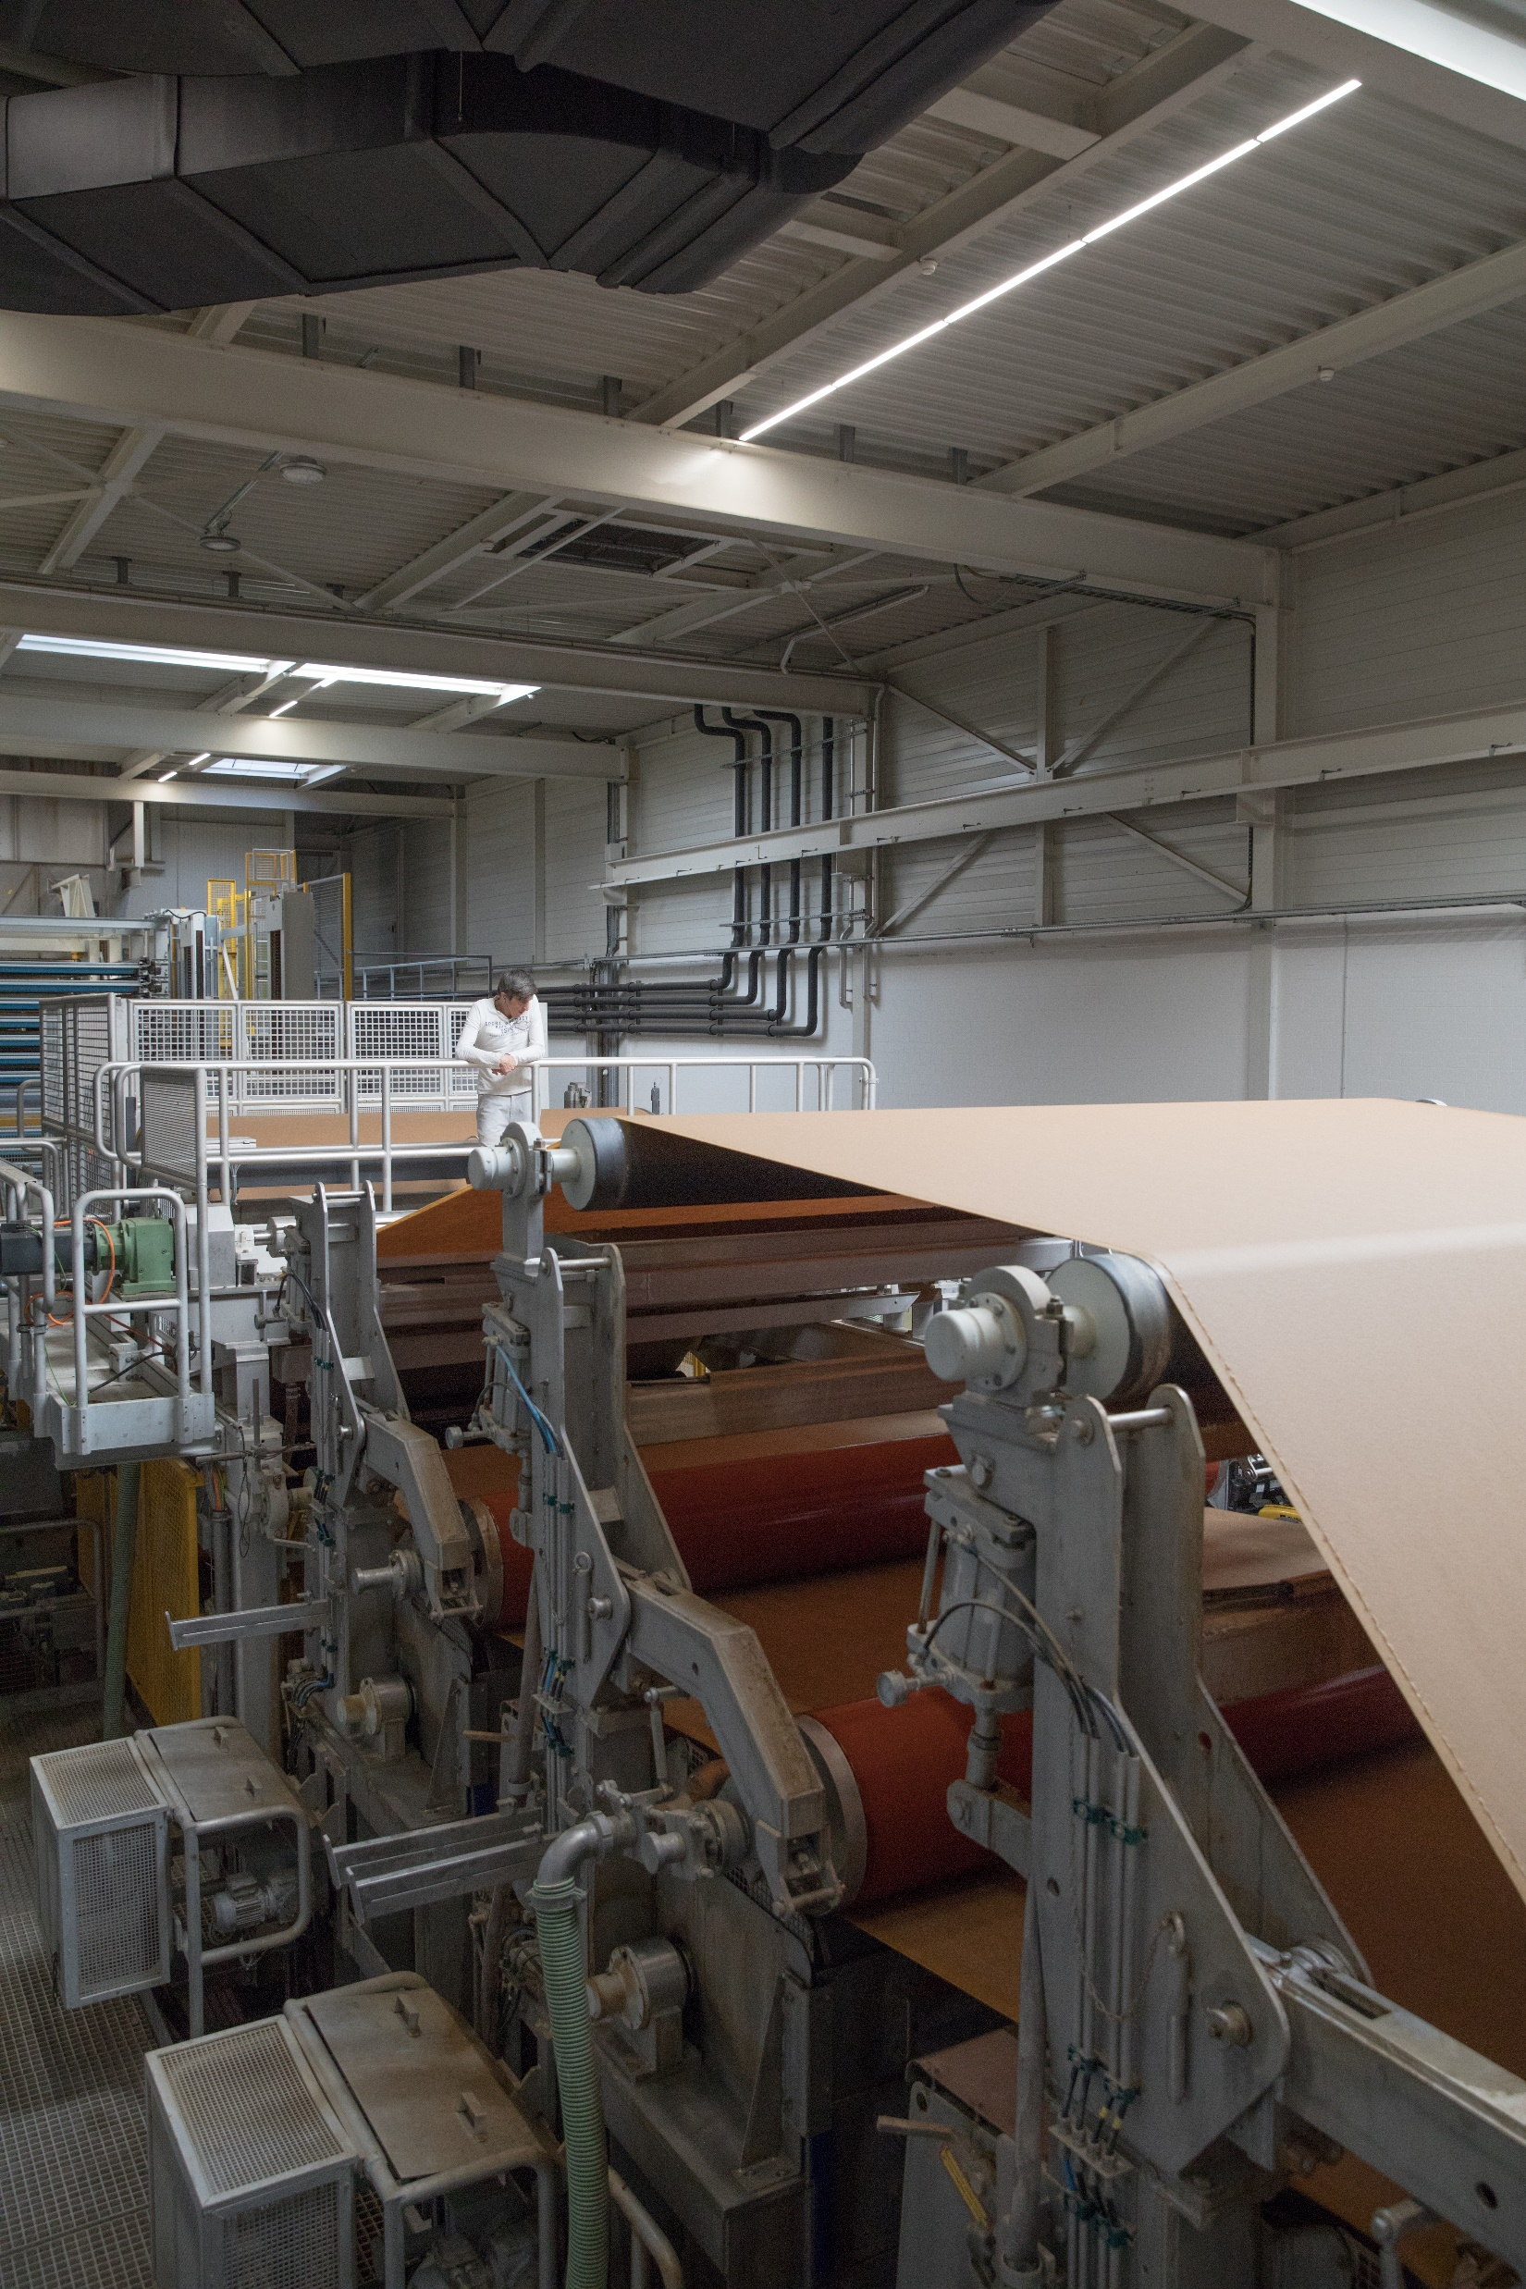
Optimized ingredients for solid transformer insulation
Cellulose fibers derived from Kraft Process
Trees
  Softwood
  From Boreal Forest
  Sustainable
    Forest Stewardship Council
Pulp
  Kraft Process
Terrestrial ecoregions of the world: a new map of life on Earth. Bioscience 2001

Slide 7
Optimized ingredients for solid transformer insulation
Water
Raw material for Transformer Insulation
  Cellulose Fibers from Kraft Process
  Water
Water must be clean with low conductivity
  Low chlorides
  Neutral pH
  Low conductivity

Slide 8
Insulation design concepts
01
Optimized Ingredients for Solid Transformer Insulation
02
Optimized Space Factor In The Windings
03
Optimized Short Circuit Resilience
04
Optimized Stress Distribution By Understanding Material Permittivity
05
Optimized Dielectric Clearances By Use Of Barrier System
06
Optimized Surface Stress Using Contoured Insulation

Slide 9
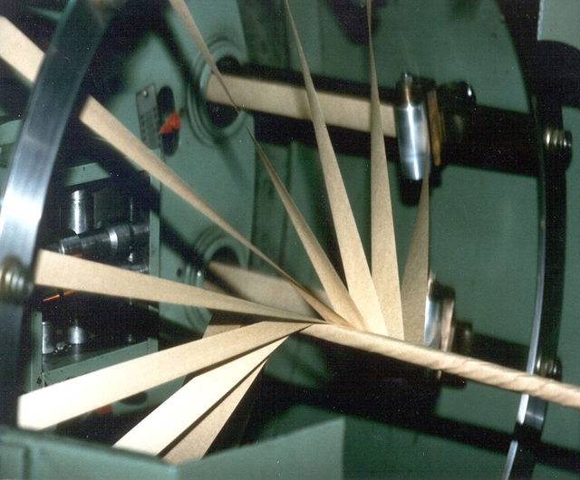
Insulation Concepts to Optimize the design of liquid-filled Transformers
Optimized Space Factor in The Windings
Conductor Insulation
High Dielectric Strength
  Determined by thickness and number of layers
Turn to Turn Thickness optimized by wrapping paper as tightly as possible.
  High tension on conductor insulation
Strength of paper
  Tensile
  Elongation
Best Conductor Insulation has High Tensile and High Elongation

Slide 10
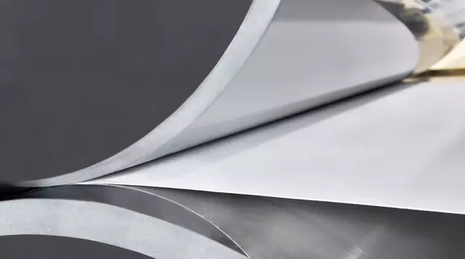
Insulation Concepts to Optimize the design of liquid-filled Transformers
Optimized Space Factor in The Windings
Conductor Insulation
Type % Elongation Use
Non-Creped 2-4 Winding Cu
Calendered Crepe 8-12 Winding Cu
Crepe 50-200 Leads
22 HCC is equivalent to “Dennison Crepe”
Known as “Calendered Crepe”
Crepe paper densified through calendering
Get thickness tolerance of Non-creped with strength of creped.

Slide 11
Insulation design concepts
01
Optimized Ingredients for Solid Transformer Insulation
02
Optimized Space Factor In The Windings
03
Optimized Short Circuit Resilience
04
Optimized Stress Distribution By Understanding Material Permittivity
05
Optimized Dielectric Clearances By Use Of Barrier System
06
Optimized Surface Stress Using Contoured Insulation

Slide 12
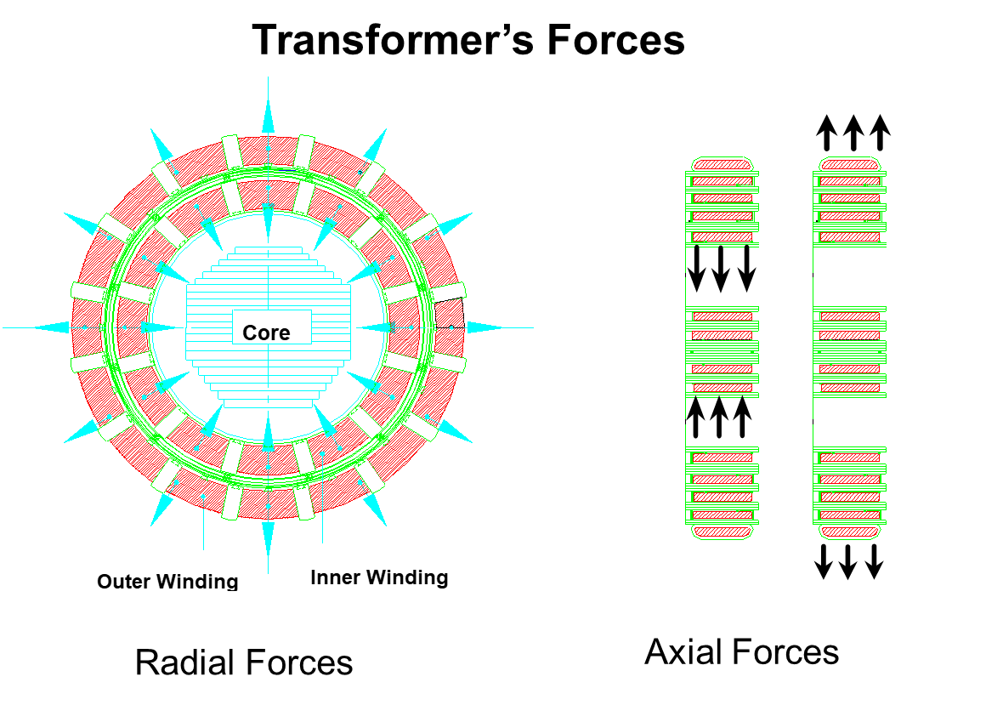
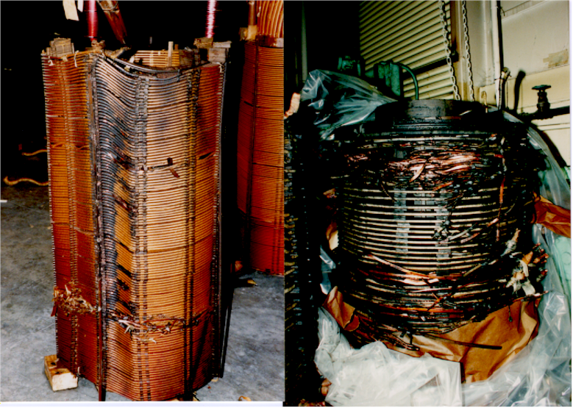
Insulation Concepts to Optimize the design of liquid-filled Transformers
Optimized Short Circuit Resilience
A major aspect of insulation is for mechanical stability of the windings
Specifically, to support the windings during short circuit events
One way to ensure windings are sufficiently supported axially is by selecting the correct radial spacer material with the optimal compressibility characteristics

Slide 13
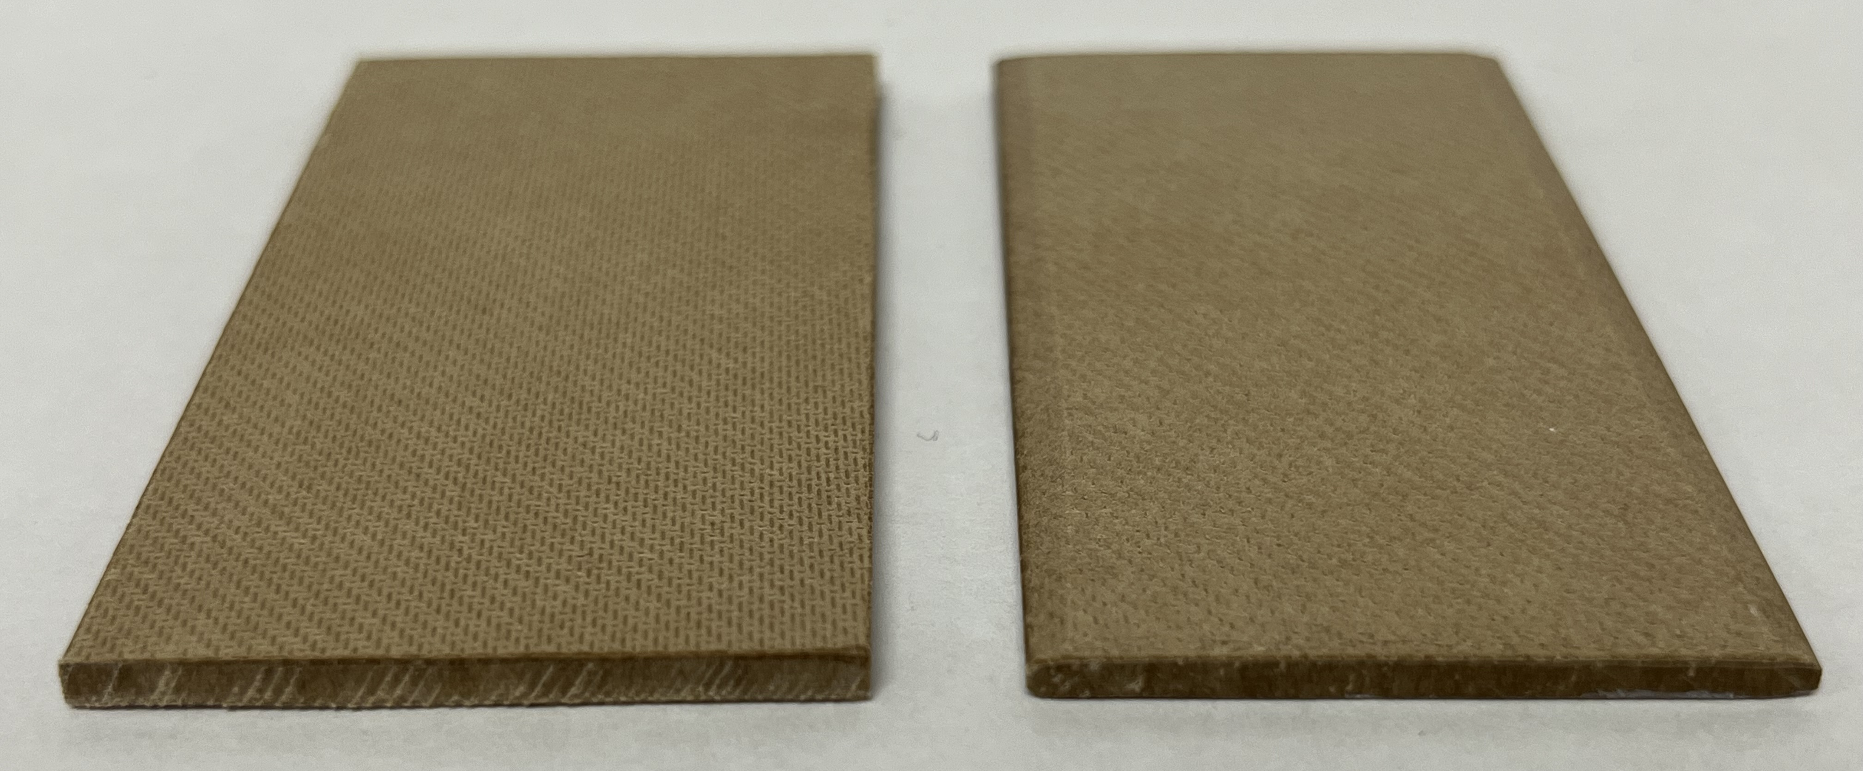
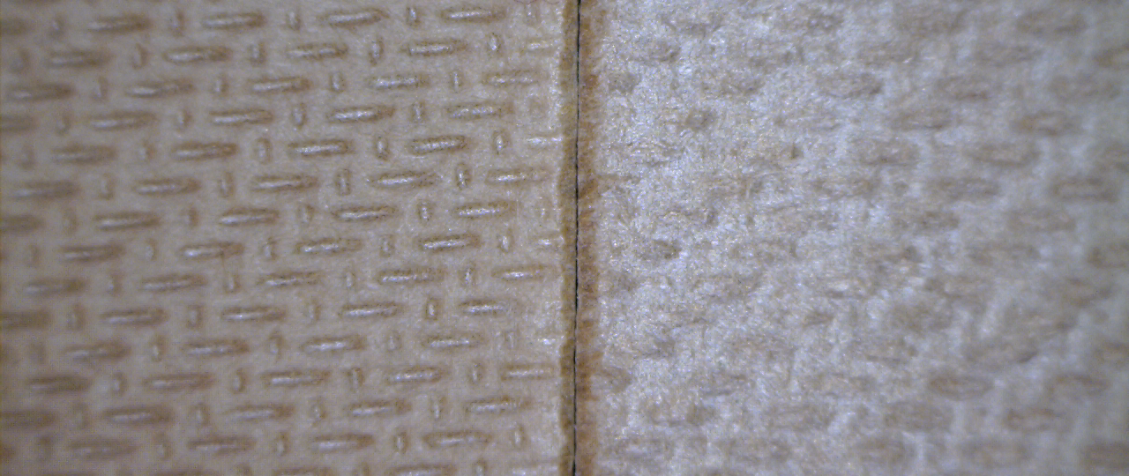
Insulation Concepts to Optimize the design of liquid-filled Transformers
Optimized Short Circuit Resilience
Compressibility can be affected by multiple properties with most significant being surface condition; milled surface vs. un-milled surface (with screen pattern intact).
Modifying the surface of the HD PB by removing the screen pattern allows for more consistent thickness and, more importantly, compression characteristics
Notes:
Compressibility factors; moisture, density, thickness (if un-milled), age
Screen pattern is approximately 0.25mm (each side) so the ratio of screen pattern to non-screen pattern is greater for thinner samples.
Compressibility spec; 1.5 mm = 10%, 2.0 & 3.0 mm = 7.5%
Reversible compressibility spec; 1.5 mm = 45%, 2.0 & 3.0 mm = 50%

Slide 14
Insulation Concepts to Optimize the design of liquid-filled Transformers
Optimized Short Circuit Resilience
Laboratory testing of various spacers showed the following:
  Un-milled surface has higher compressibility and lower reversible compressibility than milled
  Un-milled surface is largely dependent on thickness
Note: Testing completed per IEC 60641-2 section 10. Bedding pressure = 1 MPa, Compression pressure = 20 MPa.
Notes:
Compressibility factors; moisture, density, thickness (if un-milled), age
Screen pattern is approximately 0.25mm (each side) so the ratio of screen pattern to non-screen pattern is greater for thinner samples.
Compressibility spec; 1.5 mm = 10%, 2.0 & 3.0 mm = 7.5%
Reversible compressibility spec; 1.5 mm = 45%, 2.0 & 3.0 mm = 50%

Slide 15
Insulation design concepts
01
Optimized Ingredients for Solid Transformer Insulation
02
Optimized Space Factor In The Windings
03
Optimized Short Circuit Resilience
04
Optimized Stress Distribution By Understanding Material Permittivity
05
Optimized Dielectric Clearances By Use Of Barrier System
06
Optimized Surface Stress Using Contoured Insulation

Slide 16
Insulation Concepts to Optimize the design of liquid-filled Transformers
Optimized stress distribution by understanding material Relative permittivity
Relative permittivity (dielectric constant) relates the effect of the material on the capacitance of an object compared to air.
Air = 1.0
Transformer Oil = 2.2
Theoretical Pure Cellulose = 6
Typical cellulose materials (impregnated with mineral oil) have a relative permittivity ranging between 3.8 and 4.6
Notes:
Cellulose materials are less than 6 due to the areas within that material that are filled with a different material (mineral oil in the table above). Values are dependent on ratio of oil to cellulose.

Slide 17
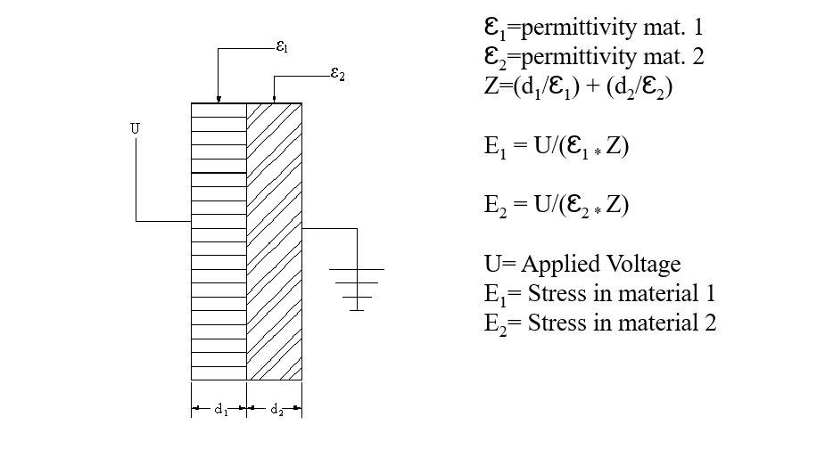
Insulation Concepts to Optimize the design of liquid-filled Transformers
Optimized stress distribution by understanding material Relative permittivity
Dielectric stress distributes inversely proportional to the material permittivity
By exchanging HD with LD board, bringing the relative permittivity of the solid closer to the relative permittivity of the liquid, the stress in the liquid was reduced by ~6%
HD PB & MO
Ꜫ₁= Ꜫ_{PB} = 4.6 U=100kV
Ꜫ₂= Ꜫ_{oil} = 2.2
d₁= d₂=5mm
E₁ = E_{PB}= 6.5 kV/mm
E₂ = E_{oil}=13.5kV/mm
LD PB & MO
Ꜫ₁= Ꜫ_{PB} = 3.8 U=100kV
Ꜫ₂= Ꜫ_{oil} = 2.2
d₁= d₂=5mm
E₁ = E_{PB}= 7.3 kV/mm
E₂ = E_{oil}=12.7kV/mm
Notes:
This will reduce the stress in the fluid, which typically sets the design clearance.

Slide 18
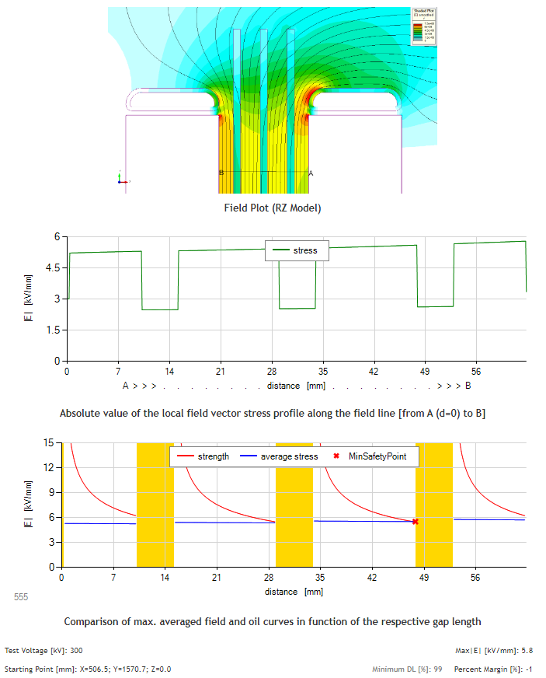
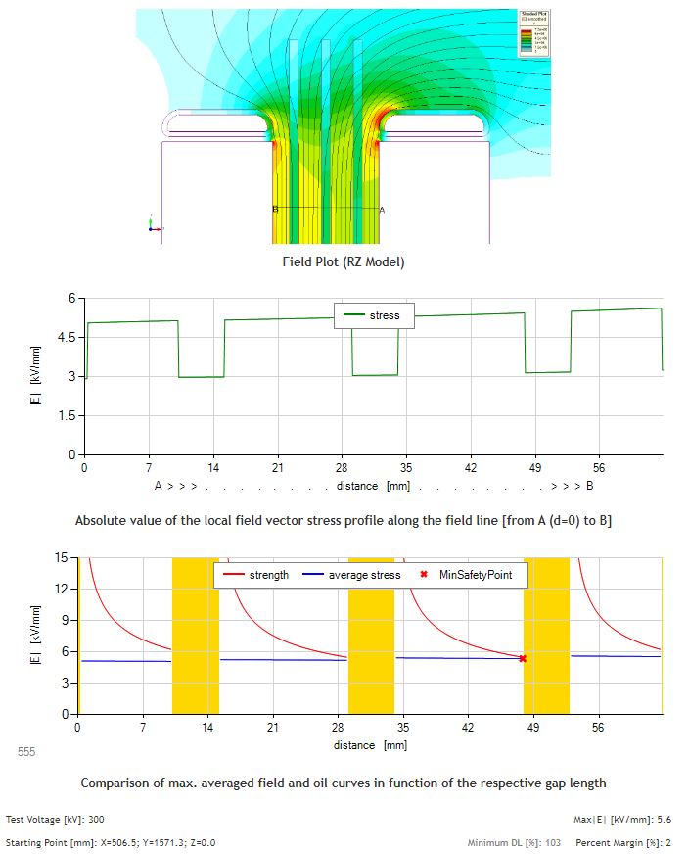
Insulation Concepts to Optimize the design of liquid-filled Transformers
Optimized stress distribution by understanding material Relative permittivity
Replacing Hi-Lo barriers from HD PB (T4) to LD PB (Hi-Val) results in a shift of the dielectric stress into the liquid and an increase in the percent margin during IDA.
-1% Margin
2% Margin
Notes:
Area in H-L space with uniform field.

Slide 19
Insulation design concepts
01
Optimized Ingredients for Solid Transformer Insulation
02
Optimized Space Factor In The Windings
03
Optimized Short Circuit Resilience
04
Optimized Stress Distribution By Understanding Material Permittivity
05
Optimized Dielectric Clearances By Use Of Barrier System
06
Optimized Surface Stress Using Contoured Insulation

Slide 20
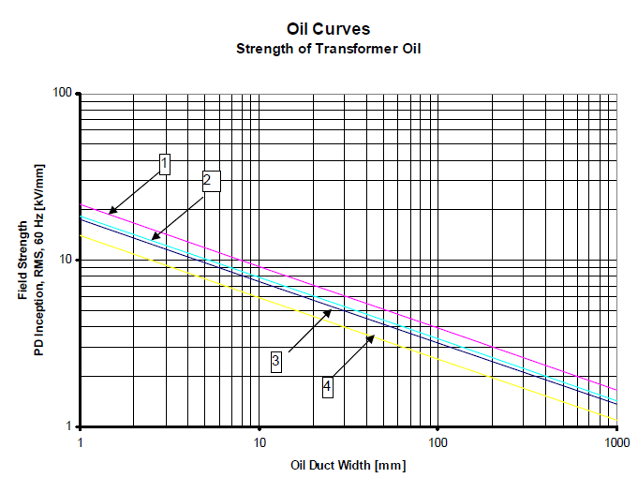
Insulation Concepts to Optimize the design of liquid-filled Transformers
Weidmann reference curves
The strength of the dielectric liquids decrease as the length of the gap increases
The inverse is also true!

Slide 21
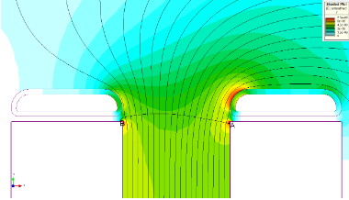
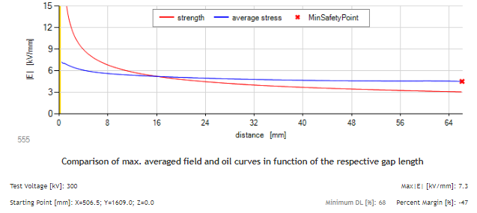
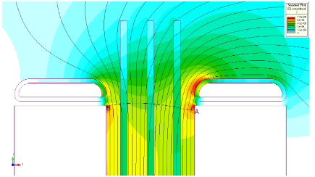
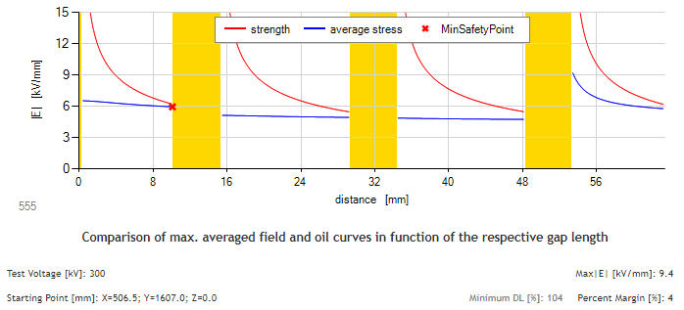
Insulation Concepts to Optimize the design of liquid-filled Transformers
Gap without barriers versus gap with 3 barriers
-47% Margin
4% Margin
Notes:
No barrier on top and 3 barriers below

Slide 22
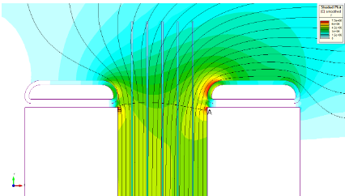
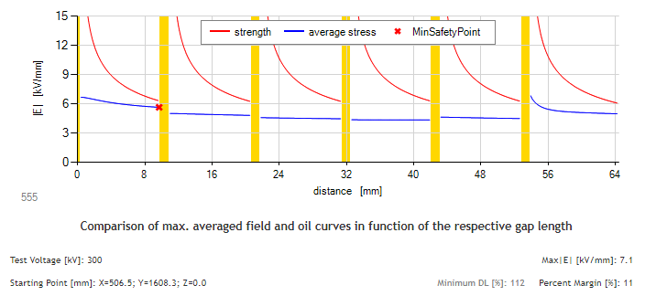
Insulation Concepts to Optimize the design of liquid-filled Transformers
Gap with 3 thick barriers versus 5 thin barriers
4% Margin
11% Margin
Notes:
3 barriers on top and 5 barriers below

Slide 23
Insulation design concepts
01
Optimized Ingredients for Solid Transformer Insulation
02
Optimized Space Factor In The Windings
03
Optimized Short Circuit Resilience
04
Optimized Stress Distribution By Understanding Material Permittivity
05
Optimized Dielectric Clearances By Use Of Barrier System
06
Optimized Surface Stress Using Contoured Insulation

Slide 24
Insulation Concepts to Optimize the design of liquid-filled Transformers
Optimized oil/Transformerboard surface Stress Using Contoured Insulation

Slide 25
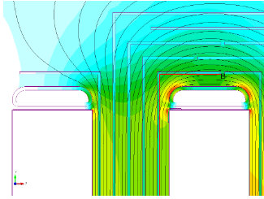
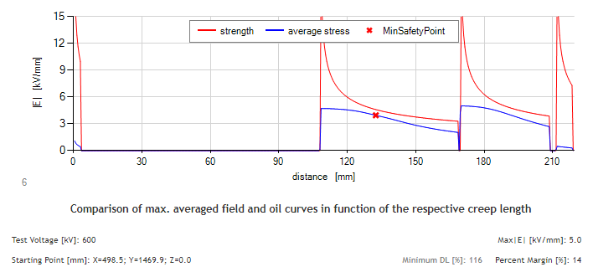
Insulation Concepts to Optimize the design of liquid-filled Transformers
Optimized oil/Transformerboard interface without contoured barriers
14% margin along the edges of the components closest to the winding

Slide 26
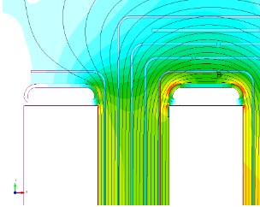
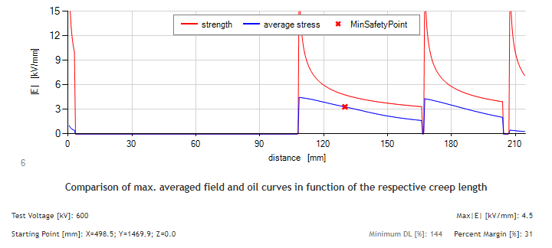
Insulation Concepts to Optimize the design of liquid-filled Transformers
Optimized oil/Transformerboard interface with contoured barriers
31% margin along the edges of the components closest to the winding
Notes:
Add text boxes with numbers pulled out

Slide 27
Insulation Concepts to Optimize the design of liquid-filled Transformers
summary
Kraft Pulp from Boreal Forest with quality water are essential raw materials for high dielectric, mechanical, and thermal performance.
By creping and then calendaring conductor insulation the strength and elongation is significantly improved allowing for high tension during the wrapping process which provides improved space factor.
By removing the screen pattern on the surface of high-density pressboard the compression characteristics are significantly improved which improves the ability to withstand axial short circuit forces.
Utilizing pressboard barriers with lower relative permittivity lowers the dielectric stress in the liquid, allowing for smaller oil gaps.
Dividing the liquid dielectric gap into smaller sub-gaps through the introduction of Transformerboard barriers allows for a smaller overall clearance.
Using contoured Transformerboard insulation can reduce the surface tangential stress on barriers, allowing for a reduction in clearances or improvement in safety margin.
Weidmann engineers utilize these concepts as well as many others to provide Optimized Insulation Design Analysis Services.

Slide 28
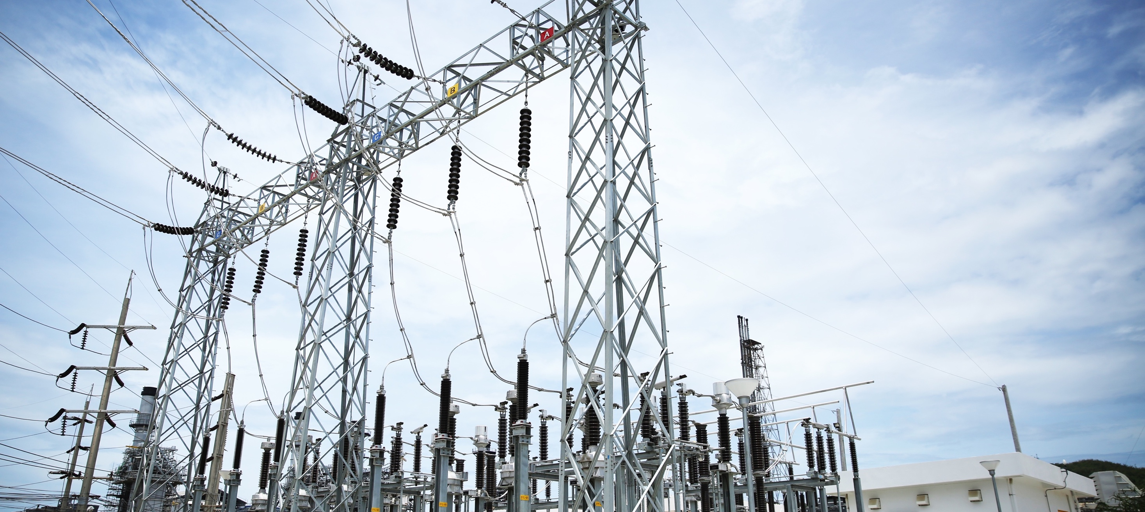
Q&A

Slide 29
Insulation Concepts to Optimize the design of liquid-filled Transformers
References
Weidmann, “Transformboard” , 1979
Weidmann, “Transformerboard II”, 1987
Weidmann, “Transformerboard III”, 2022
IEC 60641-2, “Pressboard and presspaper for electrical purposes – Par 2:Methods of tests”
D.J. Tschudi, V. Dahinden, F. Derler, “Dielectric Strength Assessment of Power Transformer Insulation”, 9th International Symposium on High Voltage Engineering, Graz, 1995
D.J. Tschudi, K. Schultz, Th. .A. Prevost, W. Ashton, M. A. Franchek, “Experimental Evidence of Transformer Insulation Design Methods”, 10th International Symposium on High Voltage Engineering, Montreal, 1997
Th. A. Prevost, “Maintaining Short Circuit Strength in Transformers”, Weidmann - ACTI Second Annual Conference, New Diagnostic Concepts for Better Asset Management, Miami Beach, Florida, USA, 2003
Th. A. Prevost, “Dielectric Properties of Natural Esters and their Influence on Transformer Insulation System Design and Performance”, Transmission and Distribution T&D Conference, IEEE / PES, Dallas Texas, 2006
Ch. Krause, “Suitable Pressboard Insulation, Relevant Dielectric Design Principles and Assembly Procedures for Building Reliable 1100 kV AC Power Transformers”, IEC/CIGRE UHV Symposium, Beijing, China, 2007
Ch. Krause, “Short-Circuit Resistant Power Transformers - Prerequisite for Reliable Supply of Electrical Energy”, CIGRE Sixth Southern Africa Regional Conference and Colloquium, Capetown-Somerset West, South Africa, 2009
D.J. Tschudi, P. Heinzig, “State of the Art Solid Insulation After 125 Years of Transformer Practice”, International Colloquium Transformer Research and Asset Management, Cavtat, Croatia, 2009
Ch. Krause, “Power Transformer Insulation - History, Technology and Design”, IEEE Transactions on Dielectrics and Electrical Insulation Vol. 19, No 6; December 2012

